Slide 1
Google Maps API
Presented by: Kelvin Gonzalez

Slide 2
Lecture Menu
Google Maps API Setup
Displaying a Google Map
Adding Markers to your Map
Converting Addresses to Coordinates
Places Nearby Search
Directions and Polylines

Slide 3
Google Maps API Setup
Access https://developers.google.com/maps
Click “Get Started”
Setup Billing Account
You will start on the Free Tier which provides $300 free credit or 90 days access
Once Free Tier is over, you must activate billing which will provide $200 monthly free credit, but will be charged if you go over the limit
Obtain and save API Key
Access “APIs & Services”
Enable desired APIs
For this demo we will be using “Maps JavaScript API”, “Geocoding API”, “Places API (New)”, and “Directions API”

Slide 4
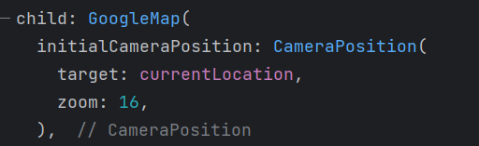
Displaying a Google Map
Install “google_maps_flutter” package
https://pub.dev/packages/google_maps_flutter
Follow platform specific instructions
Add “GoogleMap” widget to your Flutter app
Must specify initial camera position

Slide 5
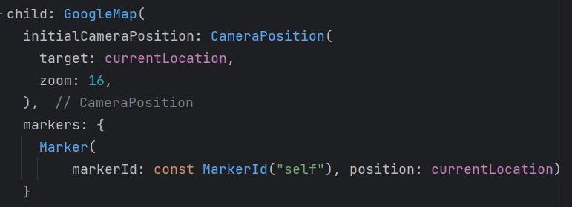
Adding Markers to your Map
Google Map widget has “markers” field
Set of Marker
Markers require a MarkerId
Specify coordinates via Marker’s position field

Slide 6
Converting Addresses to Coordinates
Geocoding API provides functionality to map a real address to coordinates on the world map
There are many Flutter packages available to make calls to Geocoding API, though it’s better to make direct HTTP requests
Geocoding API requires the address and Google API key as input

Slide 7
Places Nearby Search
Places API provides functionality to locate various other places within a specified radius from the specified world coordinates of a specified type
Ex: Find all grocery stores 1 km away from UPRM’s location
This function requires location, radius, places type list, and API key as input and returns a list of places as output

Slide 8
Directions and Polylines
Directions API will provide the entire list of actions required to go from Point A to Point B
Ex: Turn left in 500m, go straight for 1 km, etc.
It also provides other useful data such as total distance and total time elapsed
Package “flutter_polyline_points” provides resources to convert API request result into formatted Polyline data
https://pub.dev/packages/flutter_polyline_points
Directions are converted into a list of coordinates
Directions API takes as input the origin location, destination location, travel mode, and API key
The packages “google_maps_flutter” and “flutter_polyline_points” are not compatible by default, so conversion logic must be written
Add Polyline to Google Map to display on screen

Slide 9
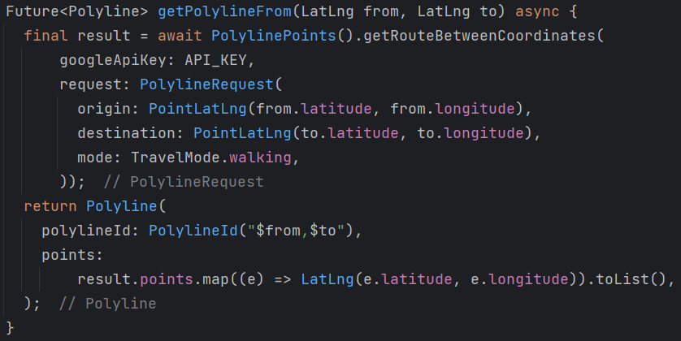

Directions and Polylines (Implementation)

